Slide 1
Linear Model for Estimating Body Fat Percentage, Group by AGE
Group 8
Lanxin Xiang
Yuyang He
Tianyue Luo

Slide 2
Background
Body fat percentage is a kind of useful way to evaluate health conditions.
However, accurate estimation for body fat percentage is inconvenient and costly.
Need to come up with a “rule of thumb” way to estimate it using available measurements.

Slide 3
Data cleaning
Abnormal points due to real situation
The two minimum points of BODY FAT are 0.00 and 1.90, which are obviously abnormal.
Also, the maximum point of BODY FAT is 45.10, with the smallest DENSITY 0.995. It is not in line with the actual situation.
Individual | Original Obs.
182 | Min.Body Fat=0.00
172 | Body Fat=1.90
216 | Max.Body Fat=45.10
The minimum HEIGHT is abnormal, with respect to 29.5 inch. However, it can be calculated with ADIPOSITY and WEIGHT.
Individual | Original Obs. | Imputed Obs.
42 | Height=29.5 | Height=70

Slide 4
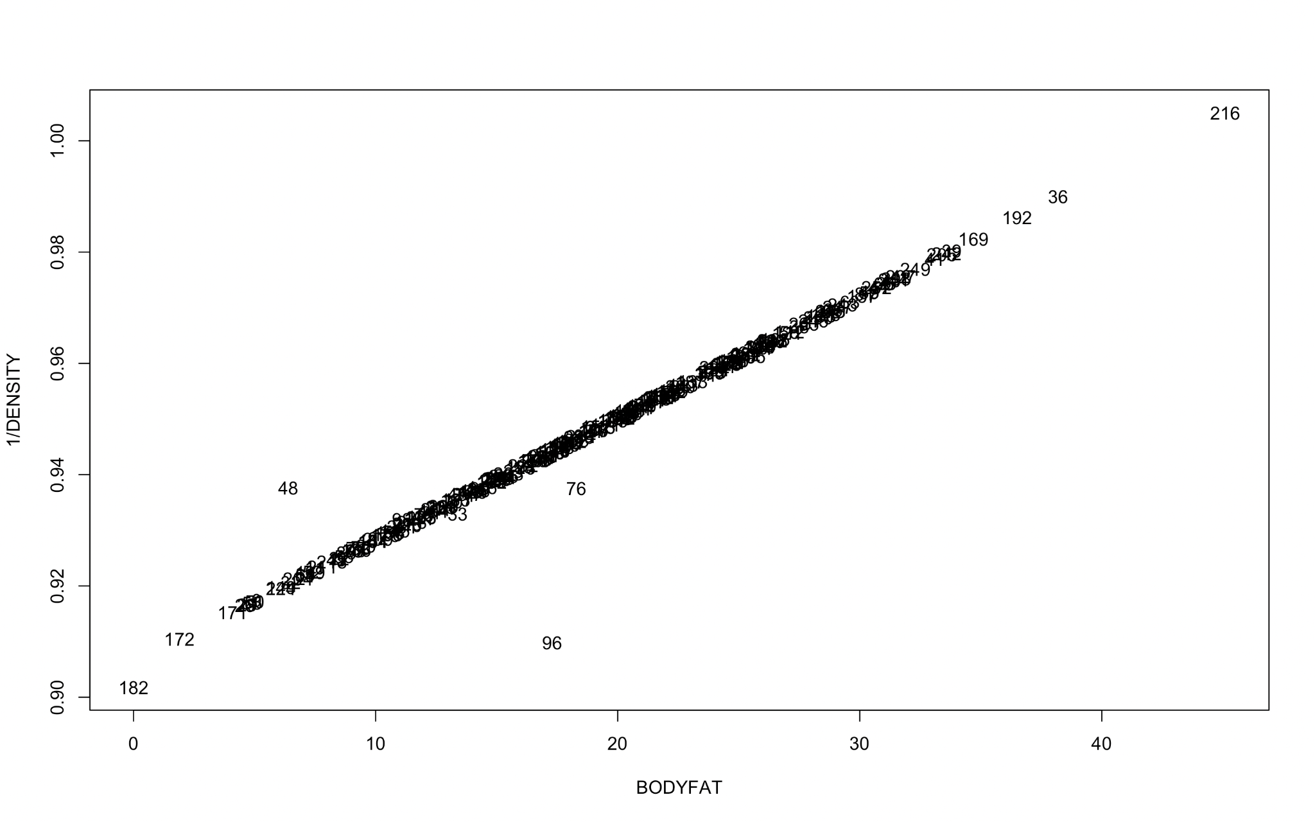
Data cleaning
Abnormal points due to linear relationship
Siri’s equation
Body Fat=495/Density-450
The percentage of body fat should have a linear function with 1/D.
According to the plot, the abnormal points 48, 76, and 96 keep away from the straight line.
It may be due to a recording error. Therefore, we delete it as outliers.

Slide 5
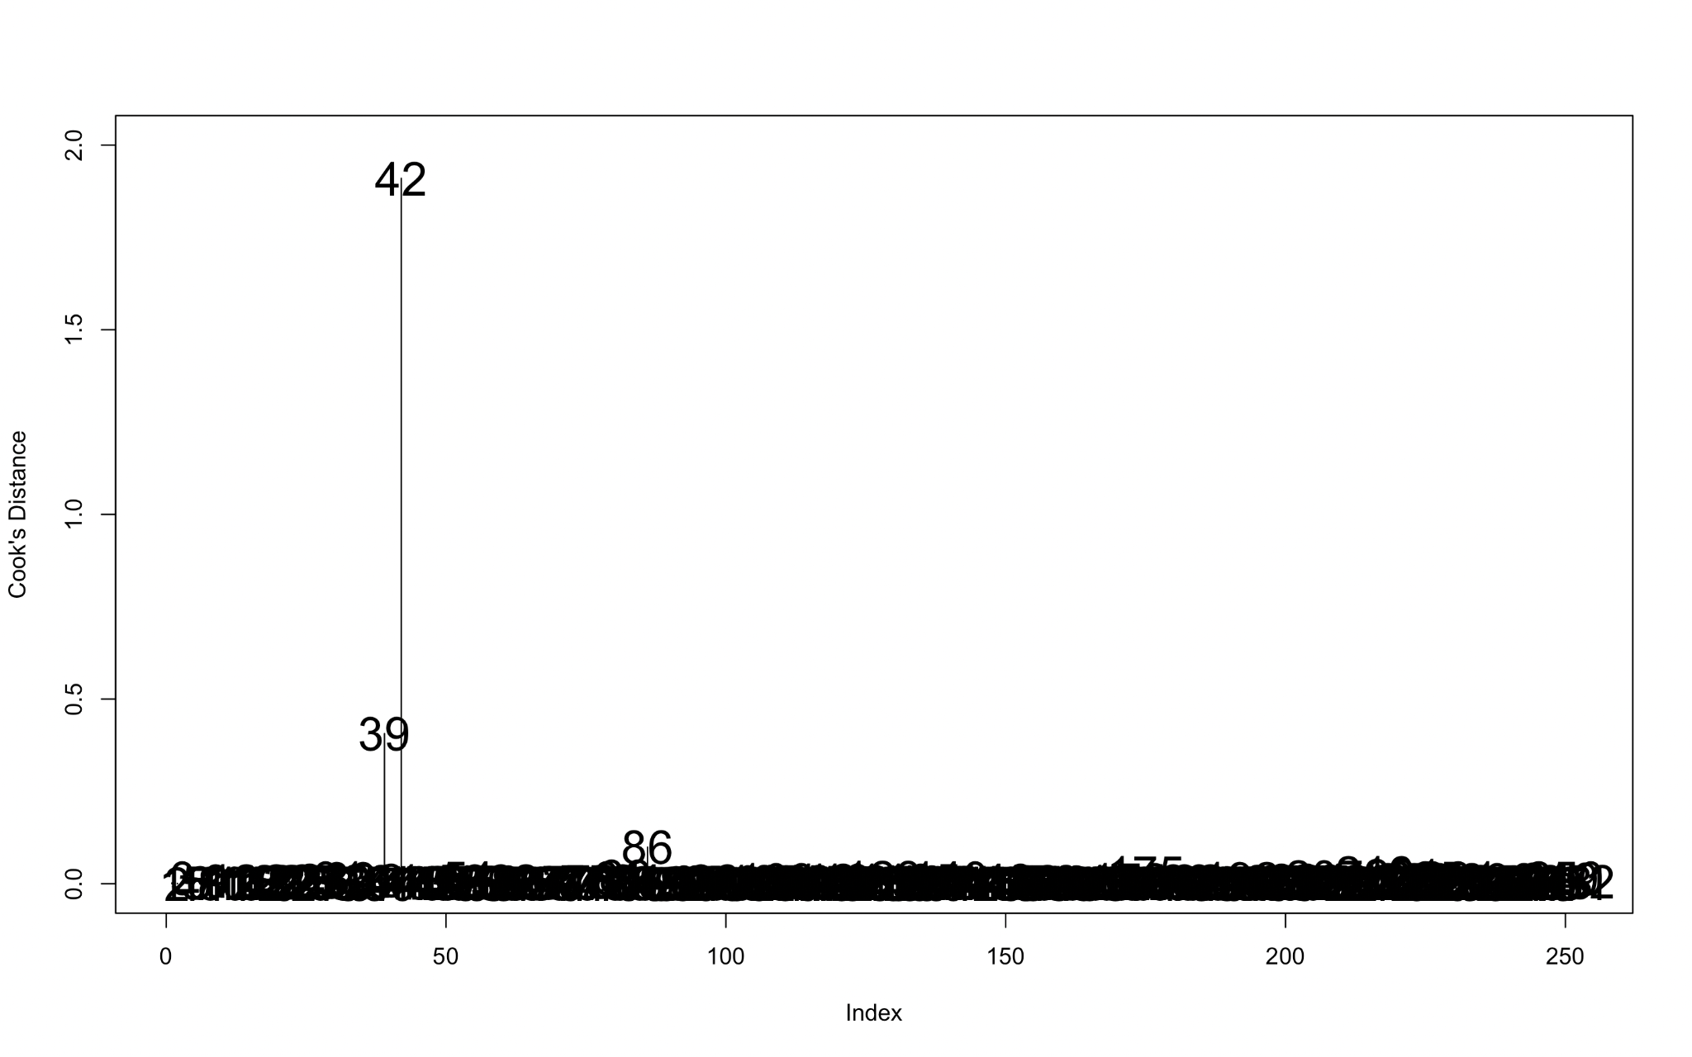
Data cleaning
Influential point
When analyzing the most influential points, we make the cook distance plot.
The points 39, 42 and 86 seem to be the most influential points.
We have already known that the 42 point is an outlier and should be replaced by other value. So finally we need to delete two influential points 39 and 86.

Slide 6
Data cleaning
Summary
We impute individual 42 due to its abnormal height.
We deleted 7 abnormal points, 39,48,76,86,96,172,182,216
Final Cleaned Data: n=244, p=14 predictors.
Predictors: AGE, WEIGHT, HEIGHT, ADIPOSITY, NECK, CHEST, ABDOMEN, HIP, TIGHT, KNEE, ANKLE, BICEPS, FOREARM, WRIST
Individual | Original Obs. | Imputed Obs. | Imputed Method
42 | Height=29.5 | Height=69.4 | √(Weight/Adiposity)

Slide 7
Finding Best Model for Body Fat
Metric for Choosing Model
Metric for Model Performance
Realistic.
A model should behave realistically. For example, people in different age groups have different physical qualities and functions, so they can be considered as different groups.
Simple to interpret and use.
A good model should be explained and make practical sense. Similarly, it should take into account the knowledge of non-specialists.
Adjusted R^2
It can show how the predictors interpret the body fat and can avoid the violation of objective facts caused by too many variables.
RMSE
To show how accurate the model is.
Residuals
To test the assumptions of the model

Slide 8
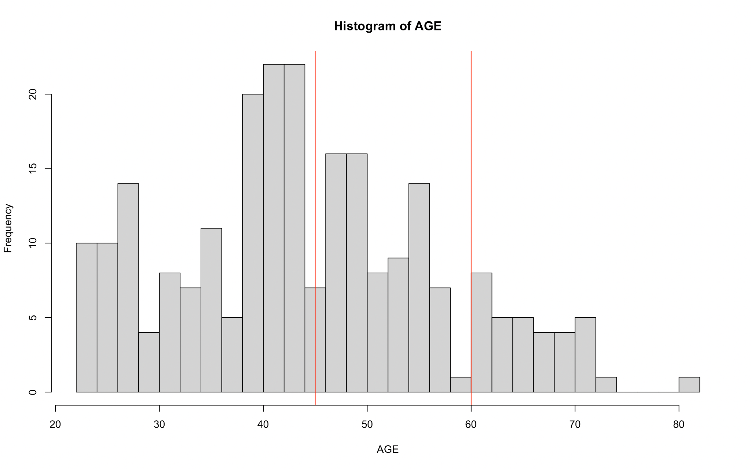
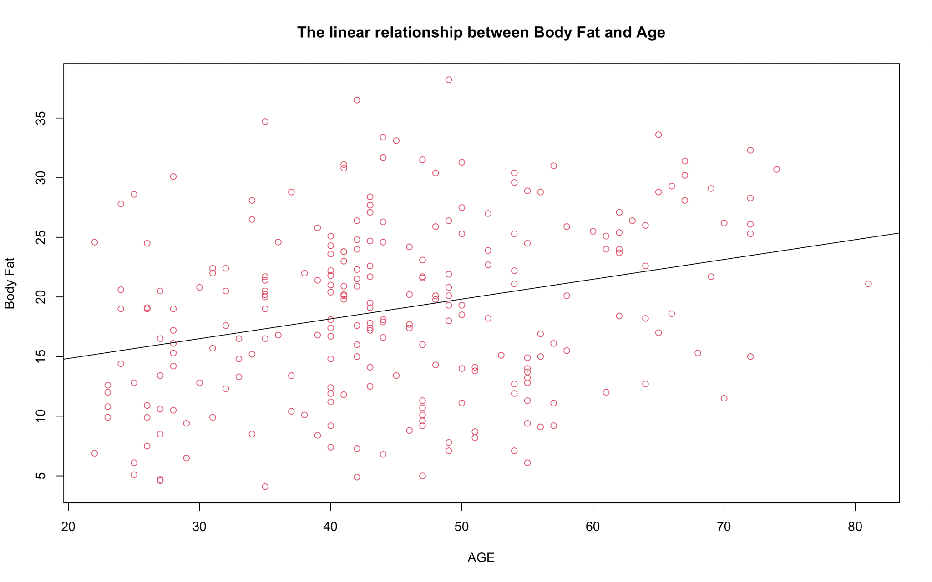
Model Motivations
Group | Age | Sample Size | Category
1 | 22-45 | 133 | Young Adult
2 | 46-60 | 77 | Middle Age
3 | 60-81 | 34 | Old Age
There are great differences in the physical conditions of people of different age groups. According to the definition of WHO, we grouped the data according to age and established models under different groups.

Slide 9
Candidate Models
Take “AGE” as a variable, called whole model.
Y~AGE+WEIGHT+HEIGHT+NECK +...+WRIST
Use stepwise method to select variables.
2. Take “AGE” as a factor, called factor model.
Y~factor(AGE)+WEIGHT+HEIGHT+NECK +...+WRIST
Use stepwise method to select variables.

Slide 10
Candidate Models
Use “AGE” to divide groups, called grouping model.
“Daily”Model
BODY FAT ~
WEIGHT+HEIGHT+ABDOMEN
“Advanced” Model
BODY FAT~ WEIGHT+HEIGHT+NECK+CHEST+ABDOMEN+HIP+THIGH+KNEE+ANKLE+BICEPS+FOREARM+WRIST
For people who only know their bodies’ basic information.
For people who only know their bodies’ detail information.
For “Advanced” Model, we use stepwise regression to select variables.

Slide 11
Results
Model |  | Adjusted R^2 | RMSE
22≤Age<45 | Daily Model | 0.6851 | 3.95
 | Advanced Model | 0.7174 | 3.71
45≤Age<60 | Daily Model | 0.7164 | 3.97
 | Advanced Model | 0.7658 | 3.56
Age≥60 | Daily Model | 0.6456 | 3.36
 | Advanced Model | 0.7243 | 2.81
Overall | Advanced Model | \ | 3.49
Whole | Advanced Model | 0.7262 | 3.80
Factor | Advanced Model | 0.7254 | 3.81

Slide 12
Final Model
Model | Age | Detailed Model
Daily Model | 22≤Age<45 | −0.14Weight−0.19Height+0.92Abdomen−28.12
 | 45≤Age<60 | -0.06Weight-0.14Height+0.82Abdomen-36.21
 | 60≤Age≤81 | -0.02Weight-0.17Height+0.56Abdomen-16.93
Advanced Model | 22≤Age<45 | -0.39Height-0.55Neck+0.74ABdomen+0.30Biceps -2.20Wrist+29.07
 | 45≤Age<60 | 0.68Abdomen+0.29Thigh-1.32Ankle+0.59Forearm -1.8Wrist-15.27
 | 60≤Age≤81 | -0.18Weight+0.77Neck+0.67Abdomen+1.81Ankle +0.75Biceps-0.80Forearm-82.07

Slide 13
Discuss Result
Model comparison
Model interoperation
Compared with the whole model and factor model, adjusted R^2 doesn’t improve significantly. However, for the accusation, RMSE improves a lot which means providing more precision.
For daily model and advanced model, the adjusted R^2 in advanced model in each age group improved on an average of 0.05. More variables do provide more information, but don’t show great influence.
The reason why we choose “Abdomen” in the “daily” model is that most fat accumulates in the abdomen. When people have the same height and weight, abdomen is the best way to show his/her body fat.
In different age groups, there are different important variables to calculate body fat, which match our ideas.

Slide 14

Description of Results
30 years old
Weight: 205 lbs
For every 1 cm increase in abdomen circumference, the change in body fat percentage is most in younger adults (0.92), and is least in old age (0.56).
In advanced models, abdomen circumference is still an important factor. However, it can be seen that the important factors are changing at different ages, indicating that there are differences in body function.
Height: 71.5inch
Daily
23.7%
Wrist:18.2cm
Forearm: 31.2cm
Biceps: 36.4cm
Neck: 39.1cm
Abdomen: 102.3cm
Advanced
26.2%
Thigh: 66.1cm
Ankle: 23.5cm

Slide 15
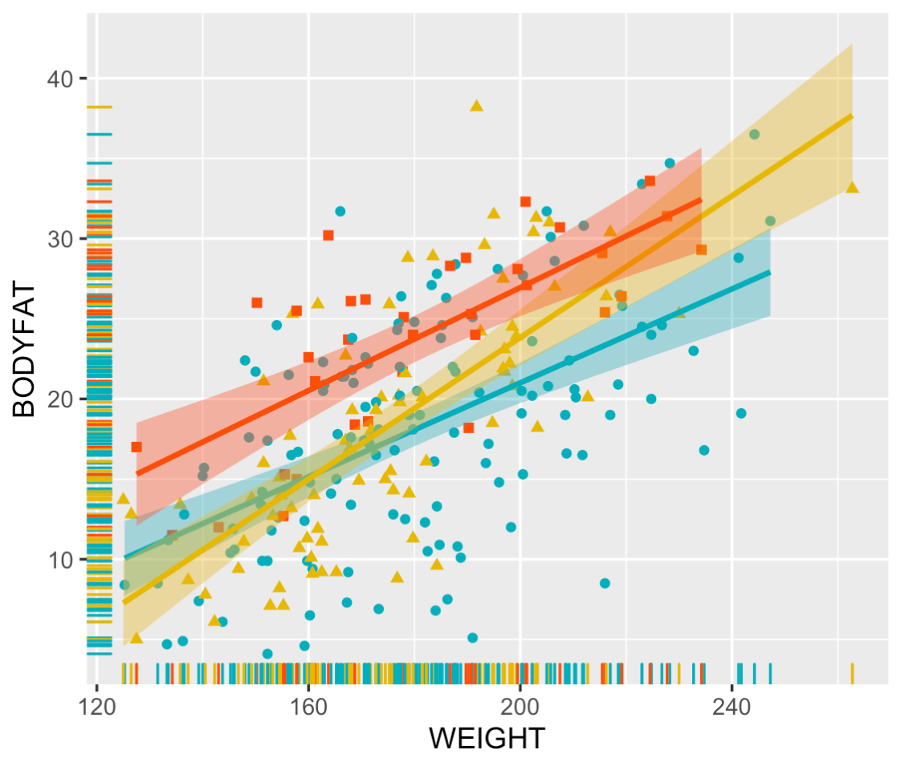
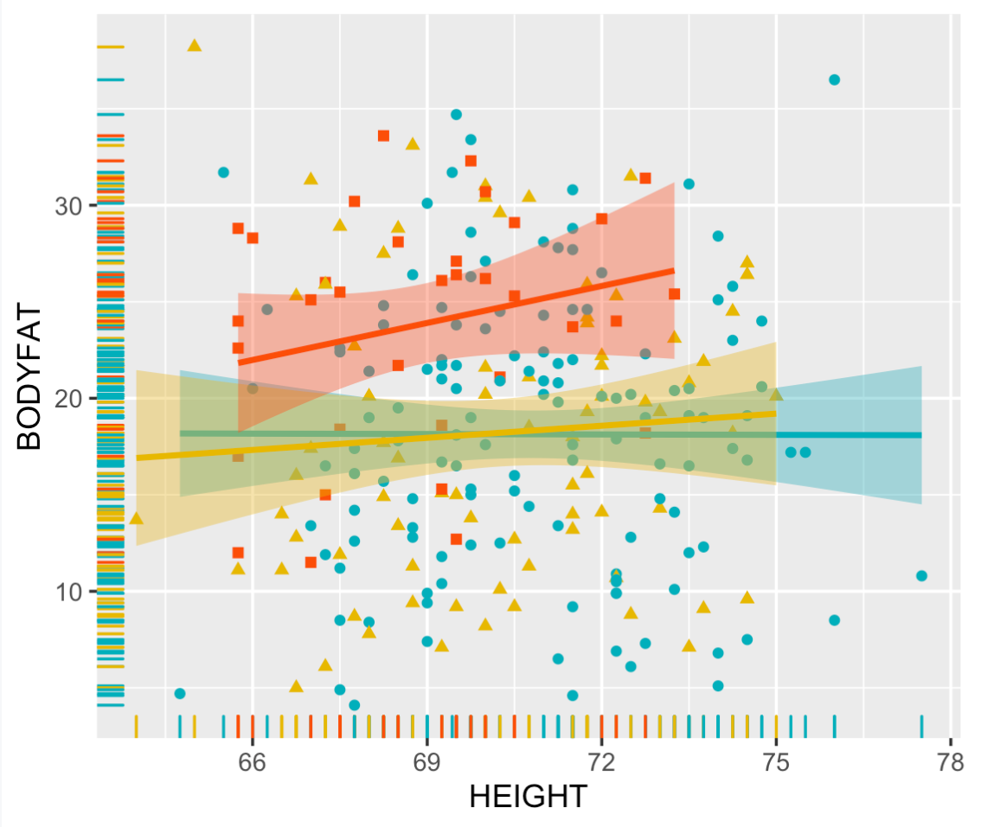
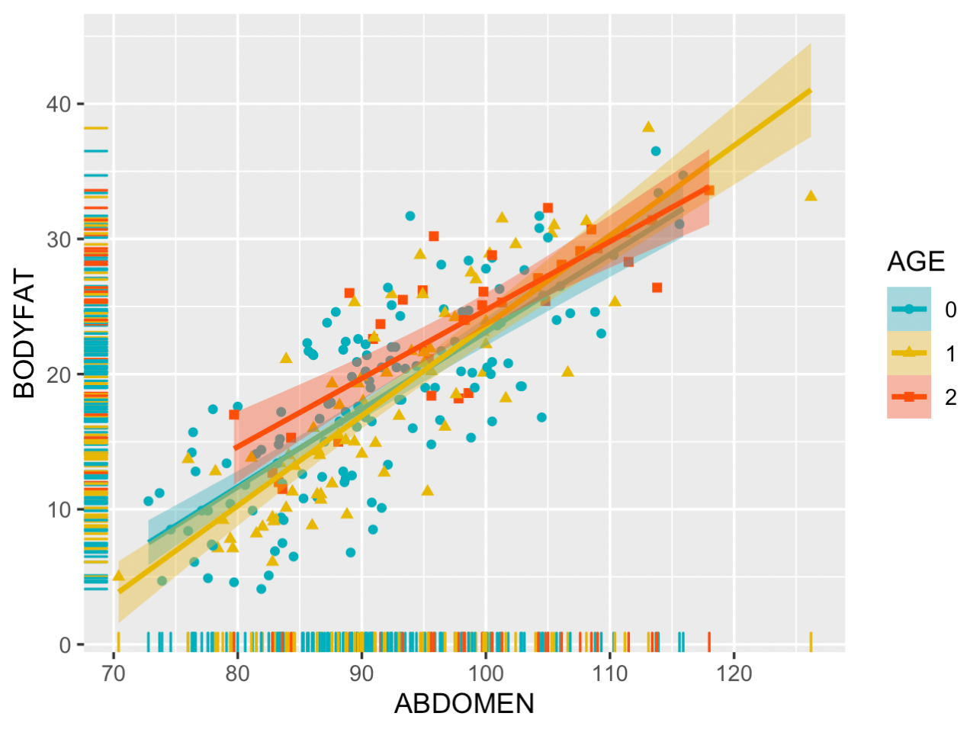
Visual Description of Final Model
In the Daily Model, there is a significant positive linear relationship in Weight and Abdomen. But not in Height. In fact, from a practical view, height is really not a significant measure of body fat.
Age division seems to be effective in the Daily model, and it can be clearly seen from the figure that the distribution of points with different colors is different.

Slide 16
Statistical Properties of Final Model
Daily Model
Models under each age group are significant at 0.05 based on F-test with p-value<2.2e-16
Abdomen in each model is significant at 0.05,with p-value smaller than 2.2e-16, 2.89e-07 and 0.00578 respectively.
The coefficients of Weight are all negative. When one person’s other predictors don’t change, weight increasing indicates increased muscle mass and then decreased body fat.
Advanced Model
All models under each age group are significant at 0.05 based on F-test.
However, there are different significant variables in different age group. Only Abdomen’s p-values are smaller than 0.05 in all models.
The fit of the age group (45<age<60) is the best, with the smallest adjusted R^2. While the age group (age>60) has the best precision, that is, the smallest RMSE.

Slide 17
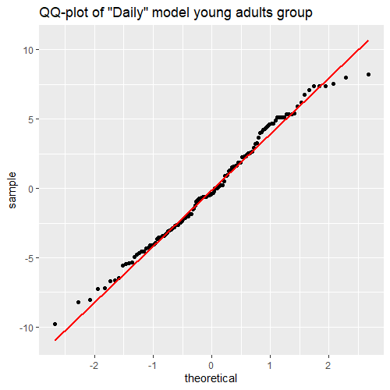
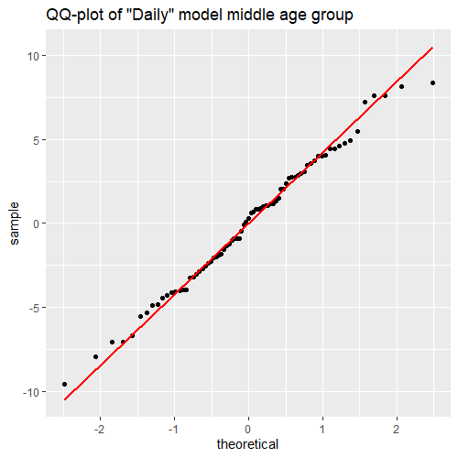
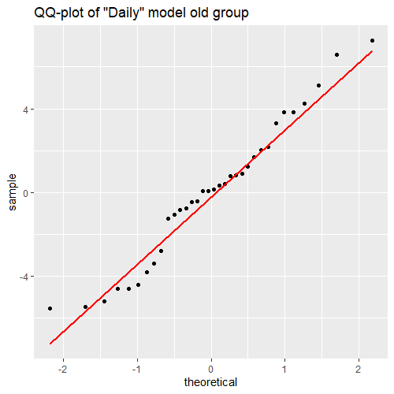
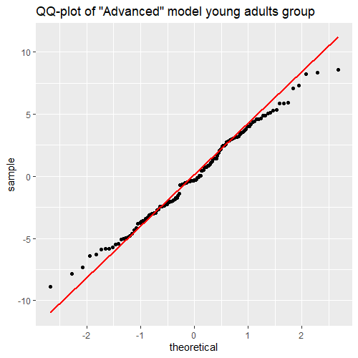
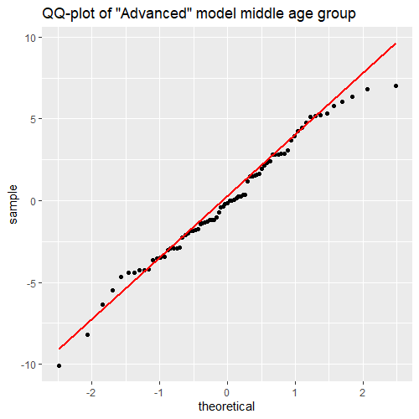
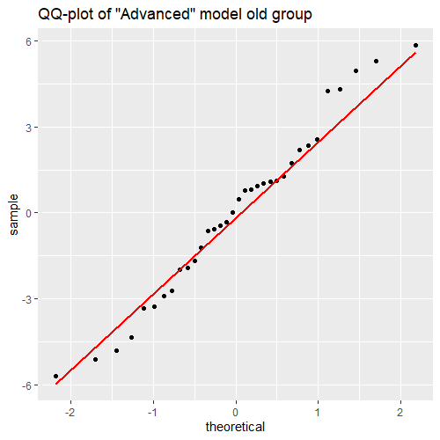
Model Diagnostics-Normality

Slide 18
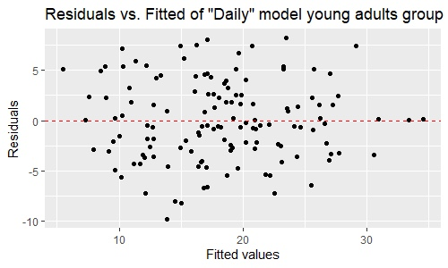
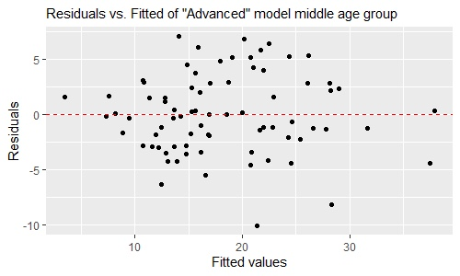
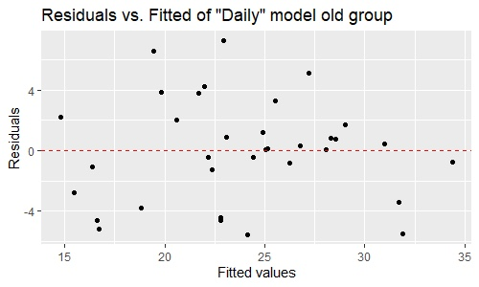
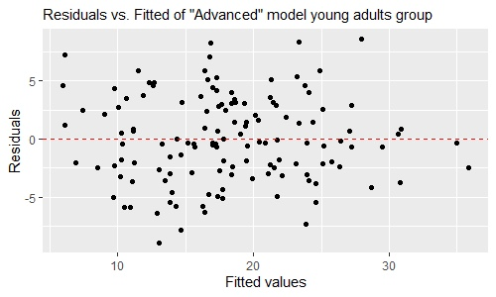
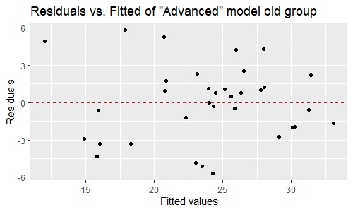
Model Diagnostics-homoscedasticity

Slide 19
Strengths and Weaknesses
Strengths
Useful. Our linear model is simple, easy to understand and interpret. It can present suitable solutions for different knowledgeable people.
Goodness of fitting. By dividing the data to three parts, our model fits better, with smaller RMSE.
Efficient. We selected model with Adjusted R^2, which guaranteed it not be overfitted, while stepwise regression method ensures the minimum AIC.
Weaknesses
The goodness of fit is constrained by linear model itself and thus, difficult to make more improvement.
To make grouping have more practical significance, the sample size of each subset is uneven.

Slide 20
Thanks！
Group 8
Lanxin Xiang
Yuyang He
Tianyue Luo

